Slide 1


Data Driven Documents D3.JS

Slide 2
My approach
Research
Look at different APIs
Read up on their history
Discover their strengths
Compare
Read through some tutorials
What does the syntax look like
Are there any downsides
Experiment
How do the APIs compare to each other
Can they be used together
Reveal strengths and weaknesses

Slide 3

Research

Slide 4
Research
There are a lot of libraries out there ( seriously, there are )
The fact it supports SVG heavily influences its popularity ( no more colouring divs! )
Its syntax is comparable to that of jQuery
D3 is one of the more popular ones

Slide 5
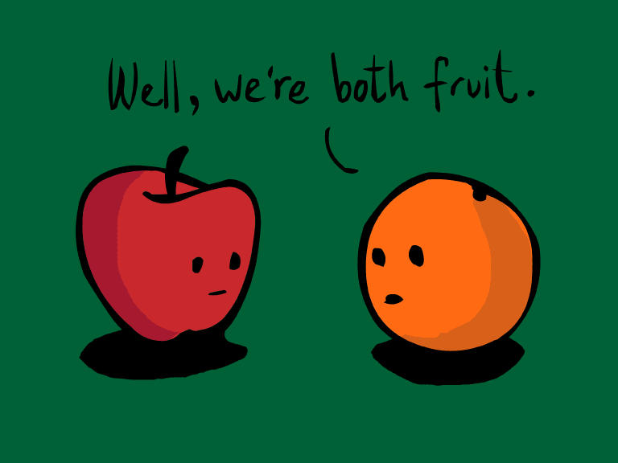
Compare

Slide 6
Compare
D3 vs Sigma vs Processing vs Raphaël vs ???
Syntax conflicts
D3 owes its popularity to the SVG-boom. People like superb looking graphics
D3 is very extensive and has a lot of community support

Slide 7

Experiment

Slide 8
Experiment
D3 is really, really, really extensive. It could be an art on its own.
It’s very powerful and complex
JSON formatted data support ( Say goodbye to separated values and xml )
Your data, you decide how it’s visualised, you’re in full control

Slide 9
Lessons learnt
Compare libraries to each other
Know what you want to do, use the applicable library for that
Keep it simple ( do you really need an animated bar chart in the colours of the rainbow? )
Displaying data in an understandable yet attractive way is a big deal

